Slide 1


Human Voice Classification and Clustering
Simran Paul

Slide 2

Agenda
Introduction
Business Use Cases
Clustering
Training with multiple models
Streamlit

Slide 3


Slide 4

Problem Statement
Develop a machine learning-based model to classify and cluster human voice samples based on extracted audio features. The system will preprocess the dataset, apply clustering and classification models, and evaluate their performance.

Slide 5
Business Use Cases
Speaker Identification:
Identify individuals based on their voice features.
Gender Classification:
Classify voices as male or female for various applications like call center analytics.
Speech Analytics:
Extract insights from audio data for industries such as media, security, and customer service.
Assistive Technologies:
Improve accessibility solutions by analyzing voice patterns.

Slide 6

Clustering

Slide 7
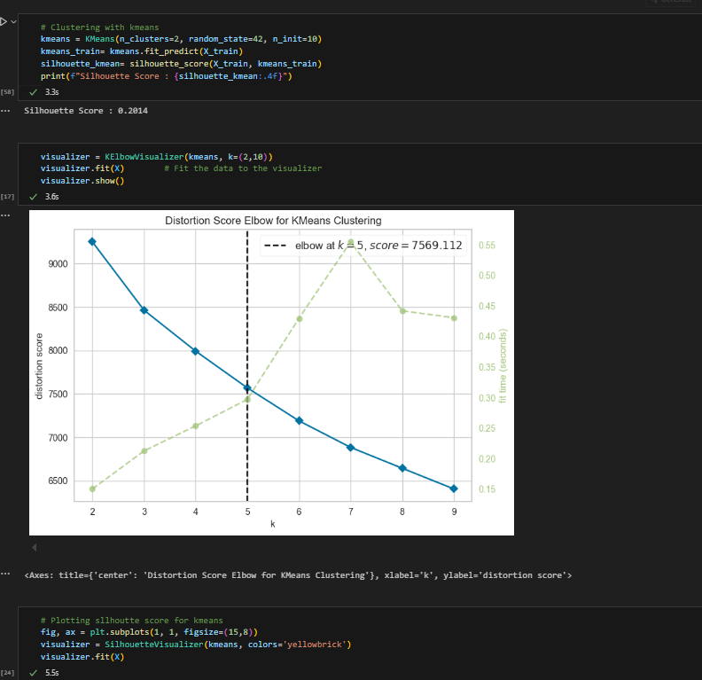
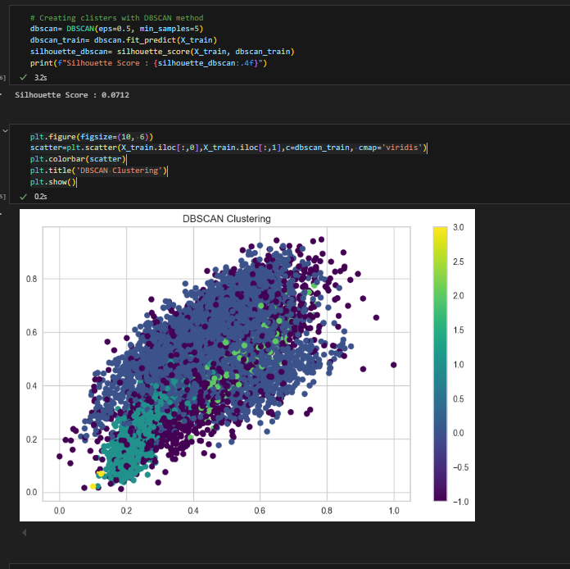
Clustering :Kmeans and DSCAN

Slide 8
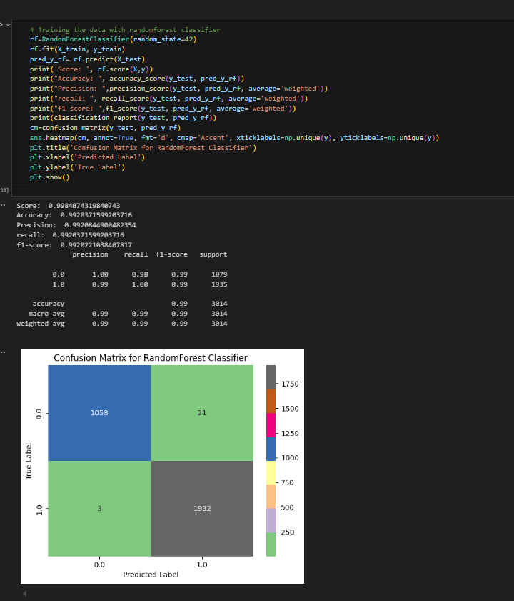
Training with multiple models

Slide 9

Training model with top 10 features

Slide 10
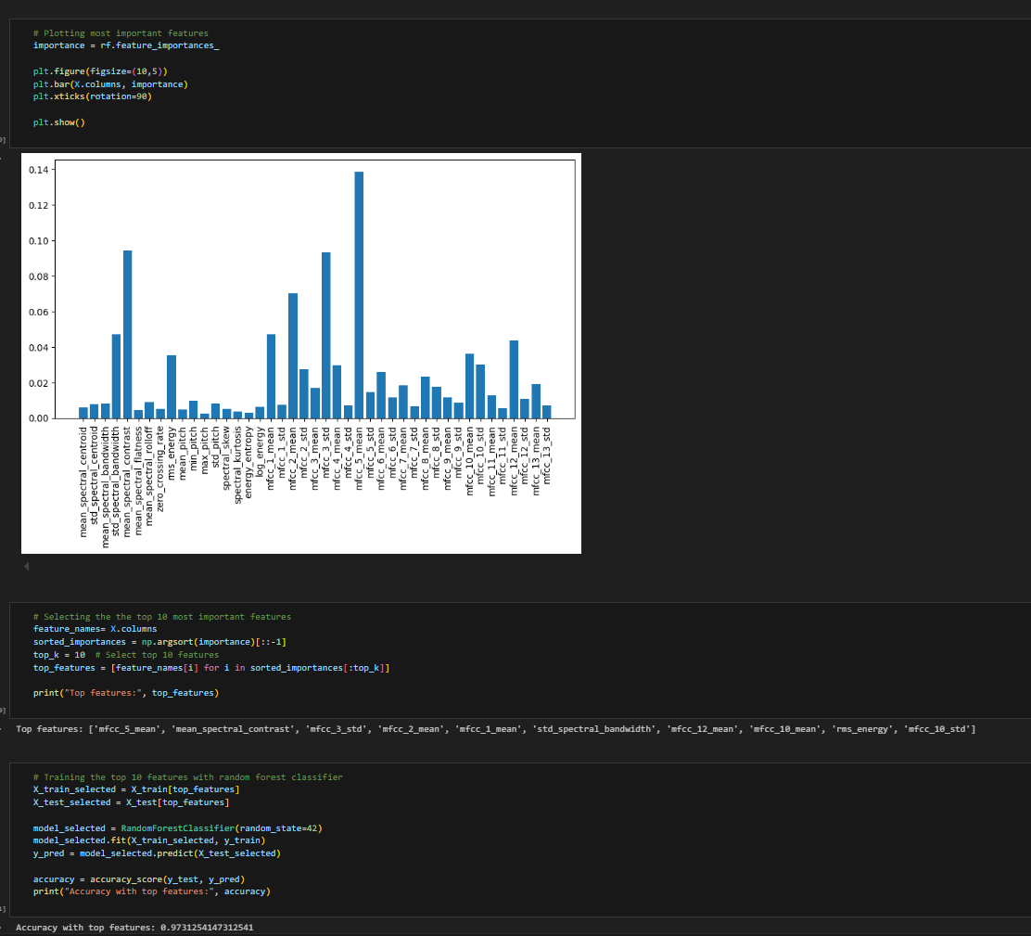

Slide 11
Streamlit

Slide 12
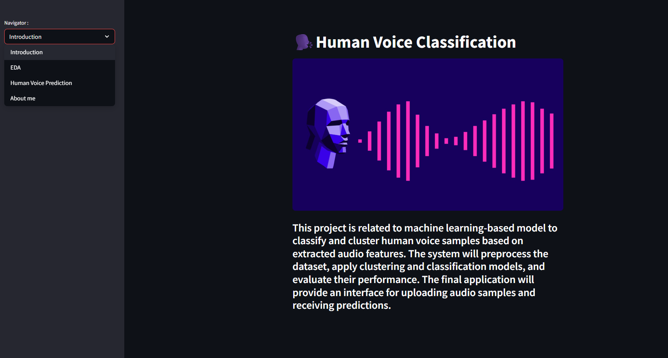

Slide 13
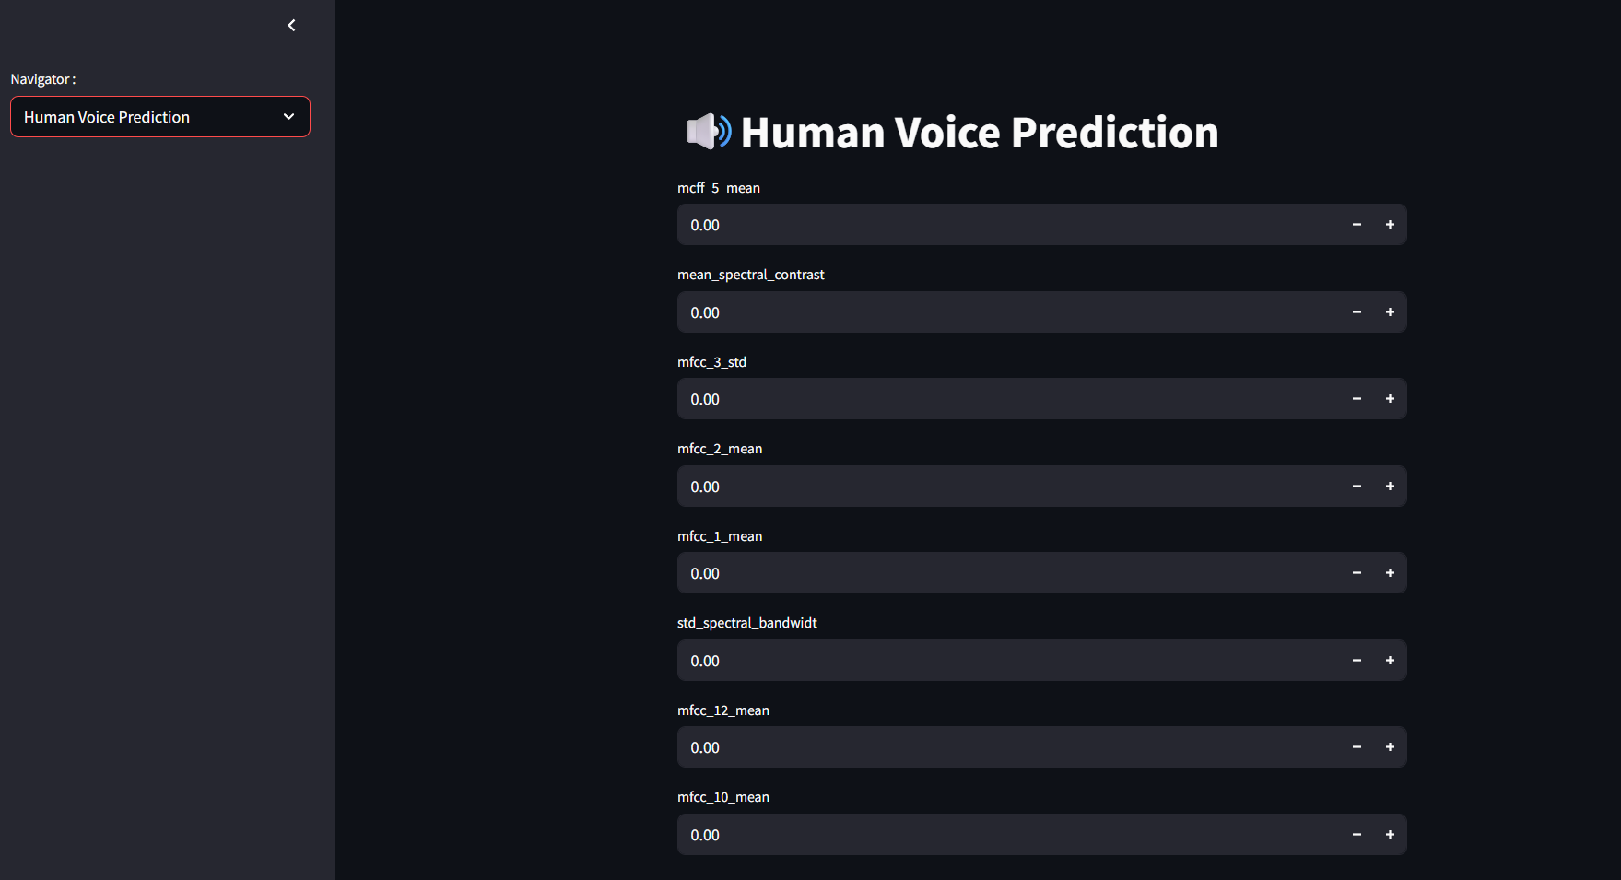

Slide 14
Thank you
Simran Paul
simranpaul1010@gmail.com

